Slide 1
Surface Plasmons

Slide 2
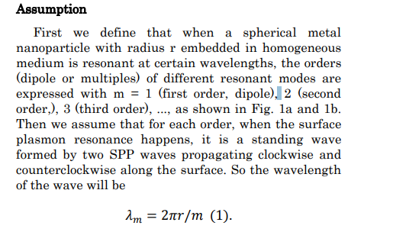

Slide 3
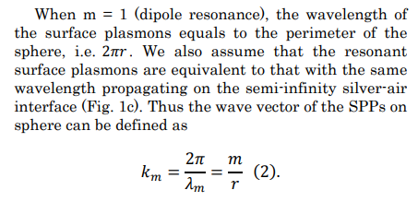

Slide 4
